Slide 1
Tasty Bites Product Pricing
&
Profitability Analysis
Report
Prepared by – Sagar Sharma

Slide 2
Introduction & Business Context
Company: Tasty Bites – a multi-city online food delivery platform
Role: Data Analyst
Goal: Improve product-level profitability without losing customers.
Business Background
Tasty Bites noticed that:
Some products have high sales but low profit
Some products generate major profit despite moderate sales
Discount-heavy categories reduce total profit
Management wants to optimize pricing, discounting, and promotions.
Objective of the Study
This analysis aims to:
Identify high-profit and low-profit products
Compare revenue vs profit by product and category
Understand the impact of discounts
Find opportunities for price adjustments
Recommend product, category, and promotion strategies

Slide 3
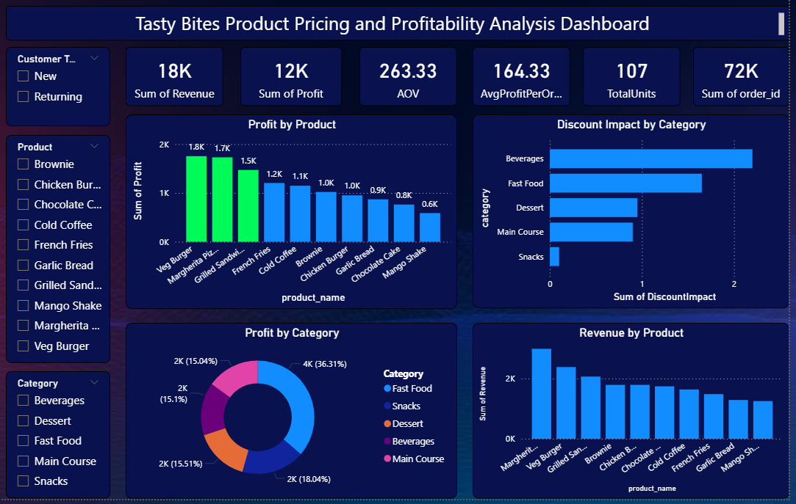

Slide 4
Key Performance Indicators (KPIs)
The KPI cards on the dashboard show:
Total Revenue: 18K
This is the sum of all sales generated from the selected period.
Total Profit: 12K
This shows the earnings after subtracting product cost.
Average Order Value (AOV): 263.33
Customers spend an average of ₹263 per order.
Average Profit per Order: 164.33
Shows the average profitability per order.
Total Units Sold: 107
Overall volume of items sold.
Total Orders: 72K
Indicates total order count during the period.

Slide 5
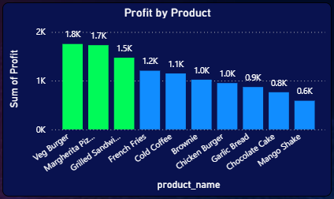
Product-Level Profitability Analysis
Profit by Product (Bar Chart)
Insights from the dashboard chart:
Veg Burger, Margherita Pizza, and Grilled Sandwich are the top profit drivers profit between 1.5K–1.8K
French Fries, Cold Coffee, Chicken Burger contribute moderate profit
Chocolate Cake and Mango Shake are the lowest-profit products (below 1K)
Key Observation
Some products have high sales but low profitability,
indicating:
High cost
High discount usage
Inefficient pricing
These products should be reviewed for price optimization.

Slide 6
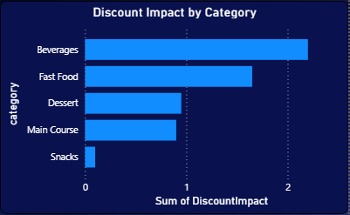
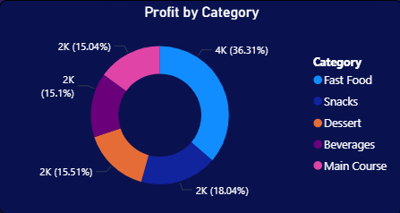
Category-Level Analysis
Discount Impact by Category (Horizontal Bar Chart)
Beverages face the highest discount impact
Fast Food also shows significant profit loss due to discounts
Snacks have minimal discount usage
Category-wise Profit (Donut Chart)
Fast Food contributes the highest share to total profit
Main Course and Dessert categories contribute moderately
Snacks and Beverages contribute the least percentage to
total profit
Key Observations
Discount-heavy categories (like beverages) reduce
overall profitability
Fast Food is the backbone of Tasty Bites profit

Slide 7
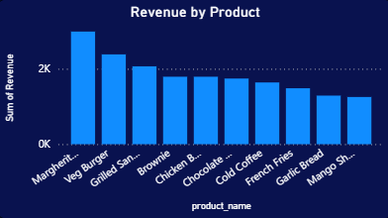
Revenue Analysis
Revenue by Product (Bar Chart)
Margherita Pizza and Veg Burger generate the highest
revenue
Cold Coffee, French Fries, Chocolate Cake generate
moderate revenue
Mango Shake contributes the least revenue
Revenue vs Profit Insight
Some products show high revenue but low profit,
which signals:
High cost of ingredients
Low pricing
Overuse of discounts
These are ideal items for pricing review.

Slide 8
Insights & Findings
1. High-Profit Products
Veg Burger
Margherita Pizza
Grilled Sandwich
These products should be promoted more or bundled for additional sales.
2. Low-Profit Products
Mango Shake
Chocolate Cake
Cold Coffee
Possible reasons:
High cost ingredients
Low pricing
High discount impact

Slide 9
3.Categories Losing Profit Due to Discounts
Beverages
Fast Food
4. High Revenue ≠ High Profit
Several products generate good revenue but have poor margins.
5. Customer Behaviour
Returning customers often buy higher-margin items
New customers tend to buy discounted items more

Slide 10
Recommendations
1. Pricing Optimization
Increase prices of products with high demand but low profit
E.g., Cold Coffee, Chocolate Cake
Keep price increases within 10% due to customer sensitivity
2. Reduce Discounts on Beverages
Beverages have the highest discount impact but low contribution to profit
3. Push High-Profit Items
Promote Veg Burger, Grilled Sandwich through:
Homepage placement
Banners
Combo offers

Slide 11
Thank You ☺

